Slide 1
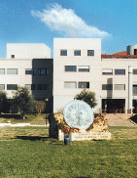
Caso Clinico
A 48-year-old female with iron-deficiency anaemia’
Dott.ssa Samanta Romeo Tutor: Prof.ssa Livia Biancone
Dott.ssa Carmelina Petruzziello
Scuola di specializzazione in Gastroenterologia
Università degli Studi di Roma “Tor Vergata”

Slide 2
Clinical Case
In July 2017, a 48-year-old female came to our SB-VCE outpatient department because of history of severe and recurrent iron-deficiency anaemia from 2015, without any sign of GI bleeding.
M. F.
48-year-old female, housewife
no smoking, alcoholic or drugs habits
no comorbidity
no concomitant drugs (no NSAIDs)
physiological menopause since Oct 2016
no gastrointestinal symptoms, anorexia or weight loss
no family history of IBD o GI disease
first degree familiarity for RA

Slide 3
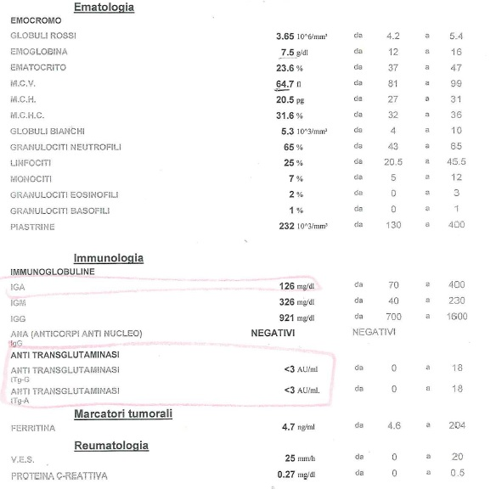
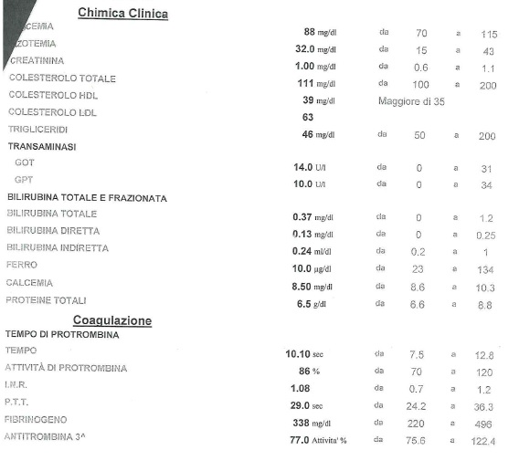
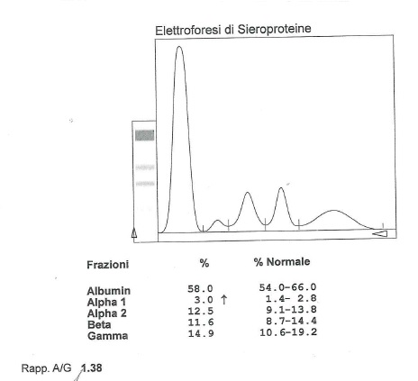
Clinical Case
April 2015:
symptomatic severe iron-deficiency anaemia (IDA)
SOF + (1/1)

Slide 4
3
Clinical Case
June 2015:
EGDS:
no lesions in esophagus, stomach and duodenal bulb
(CP test +)
ileocolonoscopy:
no lesions in ileum, colon and rectum (no biopsies)
oral iron therapy

Slide 5
July 2016: Hb 9,8 g/dl → Haematological evaluation:
Iron-deficiency anaemia
infusional iron therapy
(Ferric carboxymaltose)

Slide 6
5
July 2017: Hb 7,7 g/dl (symptomatic IDA)
Infusional iron therapy (Ferric carboxymaltose)

Slide 7
6
Clinical Case
Iron-deficiency Anaemia (IDA)
1° gastroenterological visit (July 2017)
repeat the serological tests for coeliac disease
fecal calprotectin and fecal occult blood
repeat EGDS with biopsies in DII
SICUS (Small intestine contrast ultrasonography)
Small-bowel capsule endoscopy

Slide 8
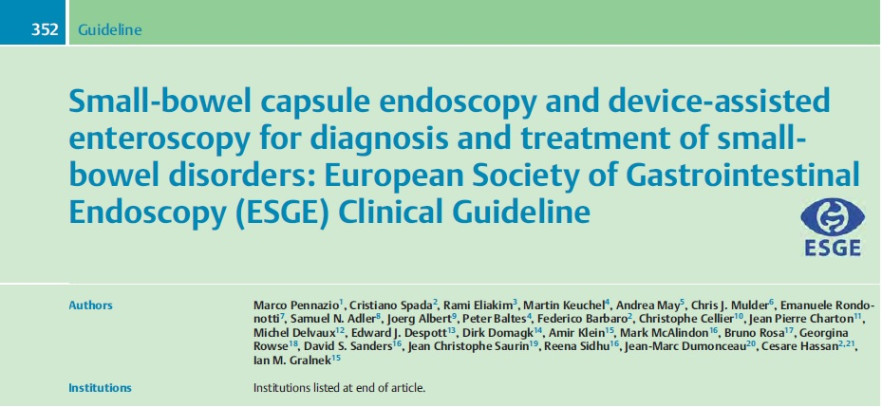
7
Iron-deficiency Anaemia (IDA)
Obscure GI bleeding (OGIB)
2015 European Society of Gastrointestinal Endoscopy (ESGE) Clinical Guideline

Slide 10
9

Slide 11
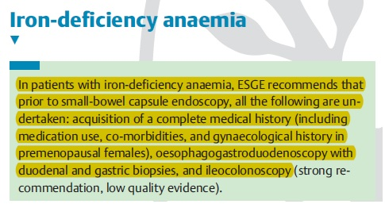
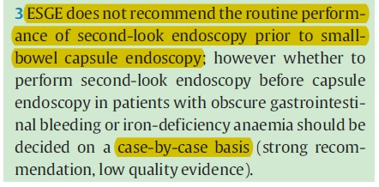
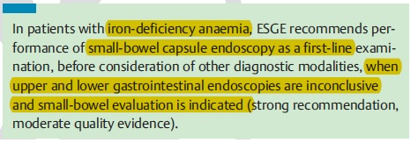
10
2015 European Society of Gastrointestinal Endoscopy (ESGE) Clinical Guideline

Slide 12
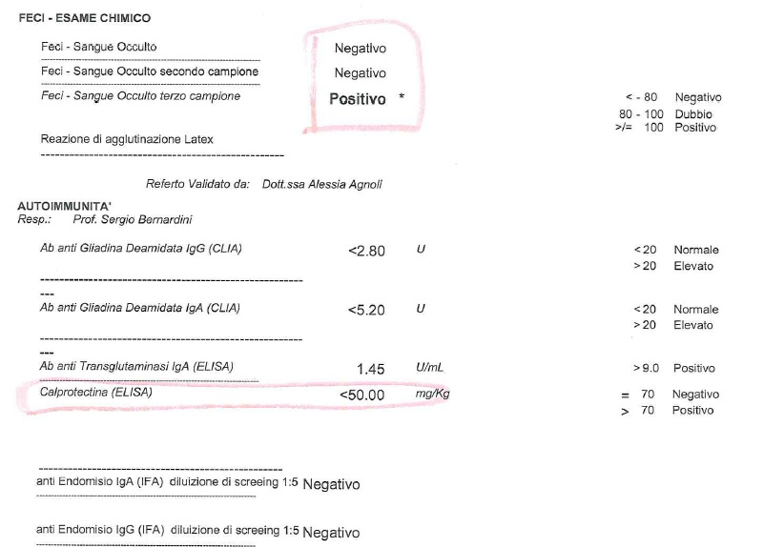
Clinical Case
EGDS (31.07.2017):
‘Esofago di normale morfologia, rivestito da mucosa rosea; giunzione EG in sede; stomaco normoconformato, rivestito da mucosa rosea; piloro centrale, continente; nulla da segnalare nella prima e seconda porzione duodenale.
EI duodenale: mucosa duodenale con lieve incremento della quota linfoplasmacellulare; villi normoconformati con rapporto villo/cripta ben rappresentato, quota di linfociti intraepiteliali nella norma.
I reperti morfologici descritti non presentano caratteri di specificità’.

Slide 13
Clinical Case
SICUS (14.07.2017):
‘… a livello del digiuno distale si visualizza ansa intestinale, per una estensione di circa 10 cm, che presenta parete di spessore lievemente aumentato (4 mm, v.n. < 3 mm); assenza di dilatazione a monte di tale tratto; valvole conniventi normorappresentate; normale l’ileo distale; assenza di versamento addominale’.
Crohn’s disease
Intestinal lymphoma
Vascular lesion
Small Bowel Tumor
?
Magnetic Resonance Enterography
(MRE)

Slide 14
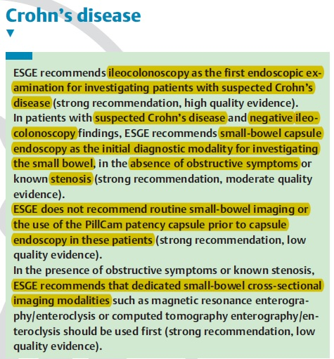
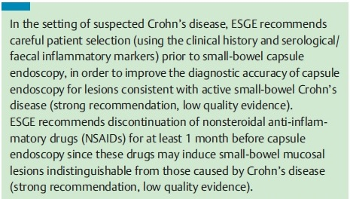
2015 European Society of Gastrointestinal Endoscopy (ESGE) Clinical Guideline

Slide 15
Clinical Case
Magnetic Resonance Enterography MRE ev and oral contrast) (26.09.2017):
‘Regolare il transito del mdc orale lungo le anse del piccolo intestino.
Regolare distensione delle anse intestinali.
Anse digiuno-ileali normali per calibro, spessore parietale e disegno mucoso; in particolare non si osservano ispessimenti o potenziamenti patologici della parete intestinale né stenosi e dilatazioni delle anse del piccolo intestino…’
SB-VCE

Slide 16
Clinical Case
SB-VCE (21.11.2017):

Slide 17
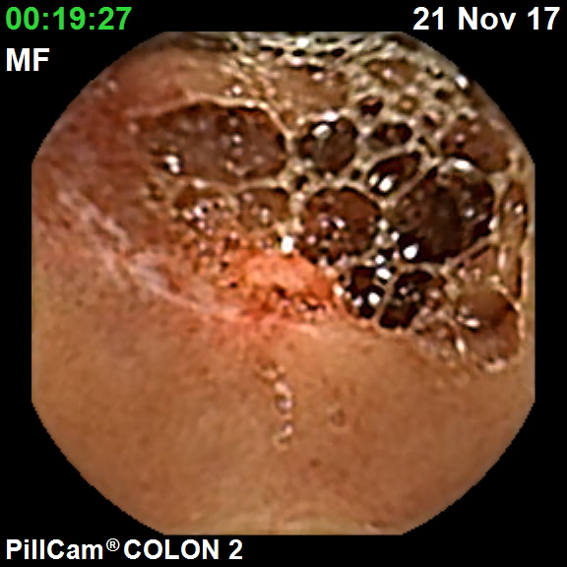
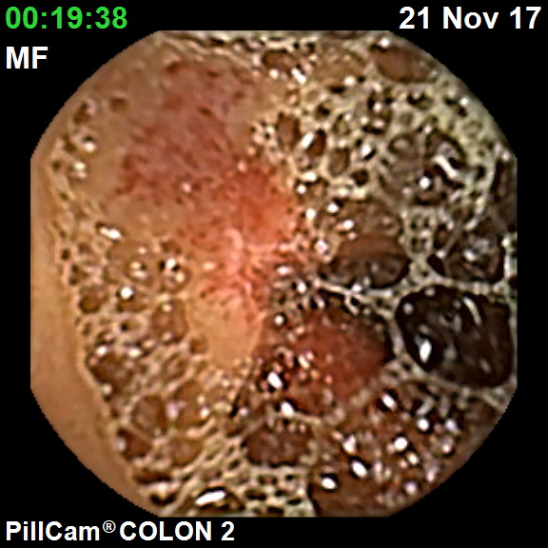
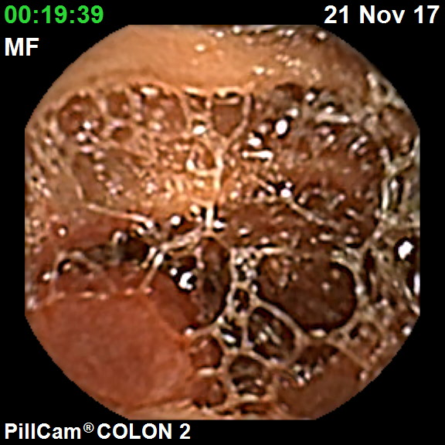
Clinical Case
SB-VCE (21.11.2017):

Slide 18
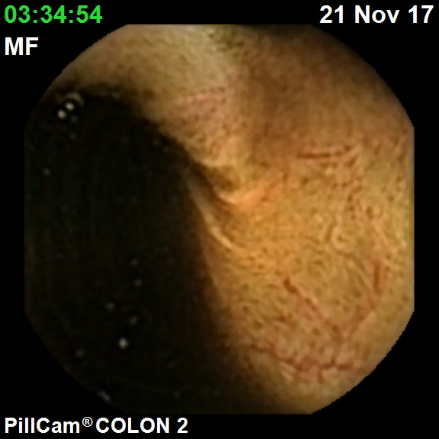
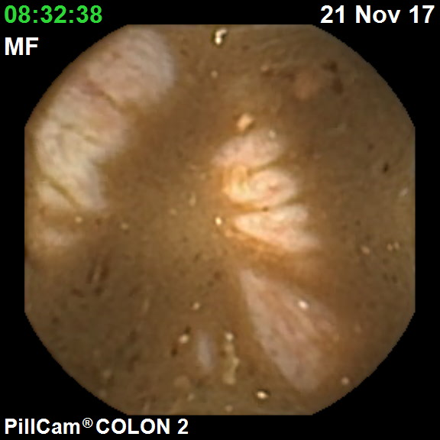
Clinical Case
SB-VCE (21.11.2017):

Slide 19
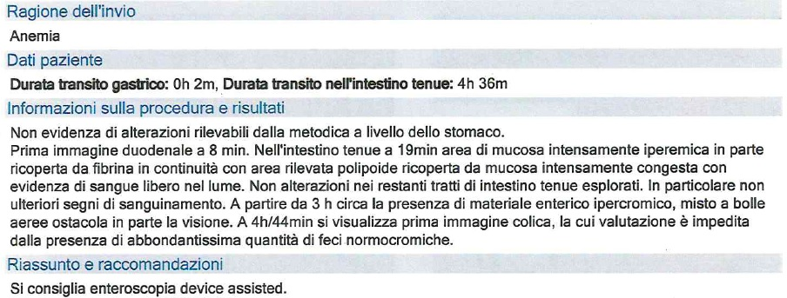
Clinical Case
2015 European Society of Gastrointestinal Endoscopy (ESGE) Clinical Guideline

Slide 20
Clinical Case
SB-VCE Diagnosis:
Small bowel polypoid lesion with active bleeding
Device-Assisted Enteroscopy
(DAE)

Slide 21
Clinical Case
Single Ballon Push and Pull Enteroscopy (28.11.2017, Dott.ssa Riccioni):
‘Accesso orale.
… Si esplora l’intestino tenue per circa 2,5 metri.
Tutti i tratti intestinali esplorati risultano normoconformati e rivestiti da mucosa normale in assenza di segni di sanguinamento in atto o pregresso’
Conclusioni: non alterazioni di rilievo a carico di esofago, stomaco, duodeno e digiuno prossimale, in assenza di segni di sanguinamento in atto o pregresso.
NO TATTOO
NO RETROGRADE ACCESS
NO MORE INDICATIONS
DISCHARGE

Slide 22
SB-VCE vs DBE
DBE and VCE show similar diagnostic yield

Slide 23
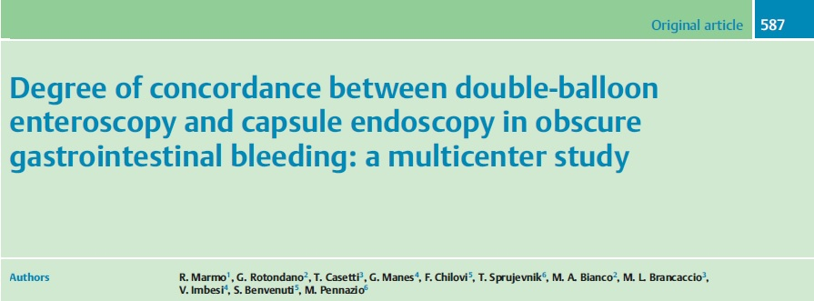
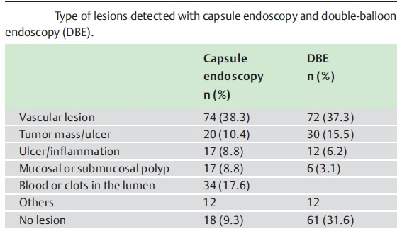
Marmo R et al, Endoscopy 2009

Slide 24
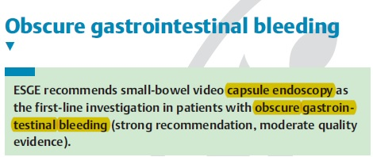
2015 European Society of Gastrointestinal Endoscopy (ESGE) Clinical Guideline

Slide 25
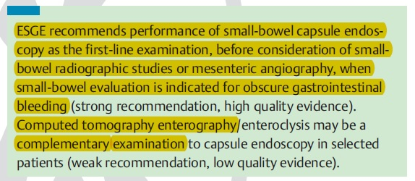
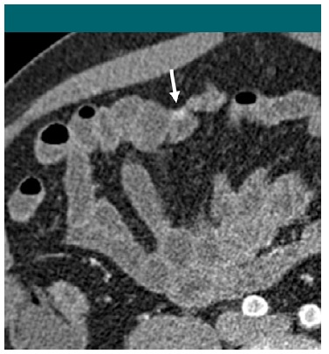
2015 European Society of Gastrointestinal Endoscopy (ESGE) Clinical Guideline
Hupric JE et al, Radiology 2011

Slide 26
2015 European Society of Gastrointestinal Endoscopy (ESGE) Clinical Guideline
Hupric JE et al, Radiology 2011

Slide 27
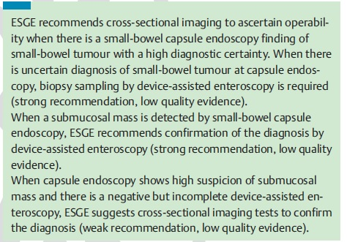
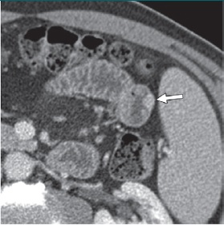
2015 European Society of Gastrointestinal Endoscopy (ESGE) Clinical Guideline

Slide 28
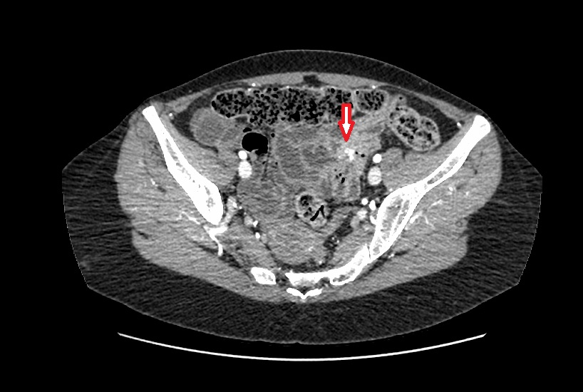
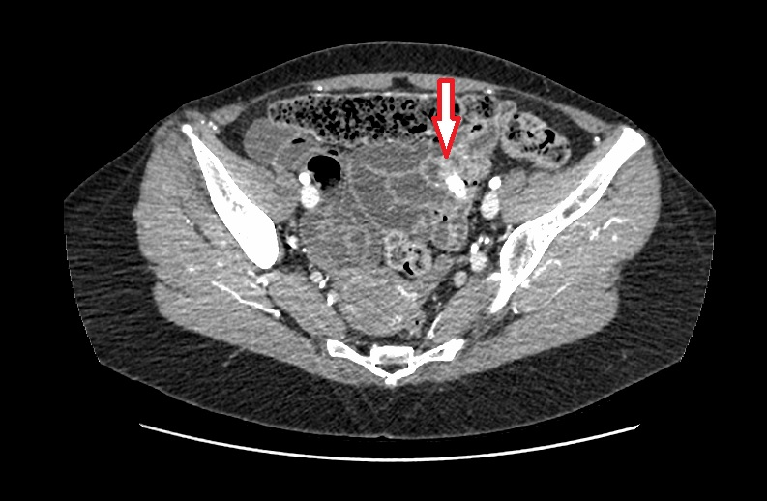
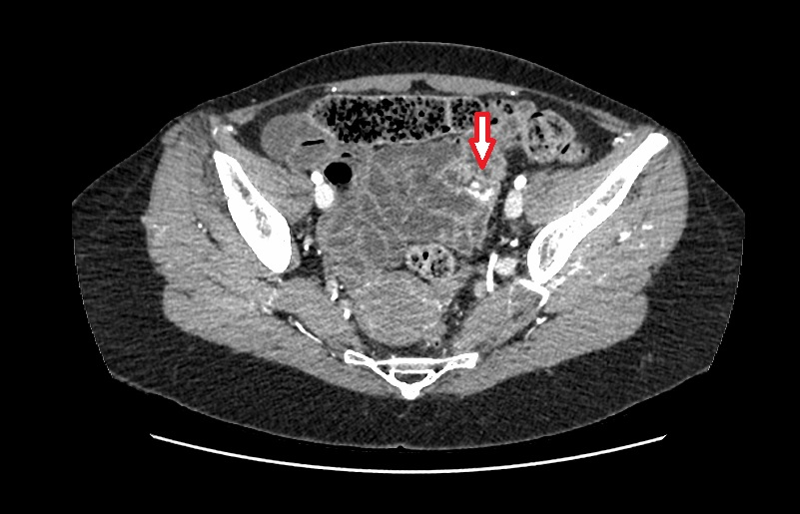
Clinical Case

Slide 29
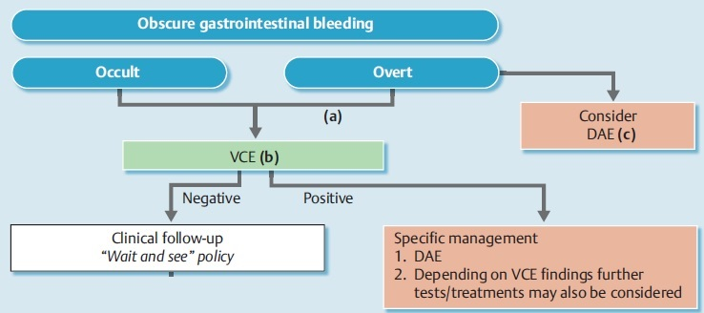
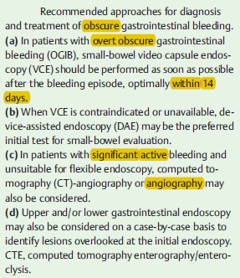
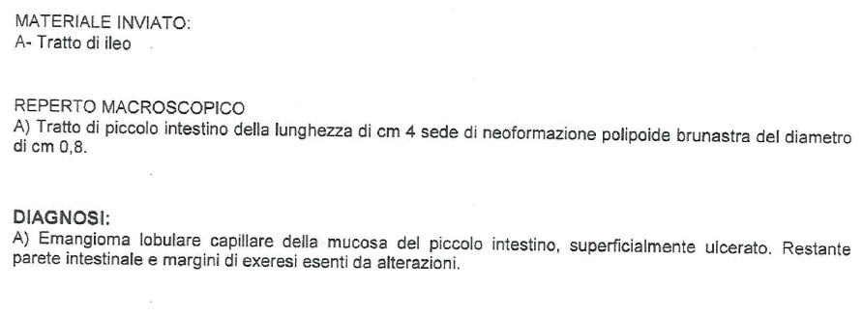
Clinical Case
HOSPITALIZATION (12.02.2018 – 17.02.2018, Osp. San Giovanni)
Angiography (12.02.2018): no active bleeding
Surgery: Ileal Resection VLS (13.02.2018)
DISCHARGE (17.02.2018)
Diagnosis:
2015 European Society of Gastrointestinal Endoscopy (ESGE) Clinical Guideline

Slide 30
Clinical Case
Follow-up:
Laboratory test (02/2018):
Hb 10,5 g/dl
Oral Iron Therapy on going.

Slide 33
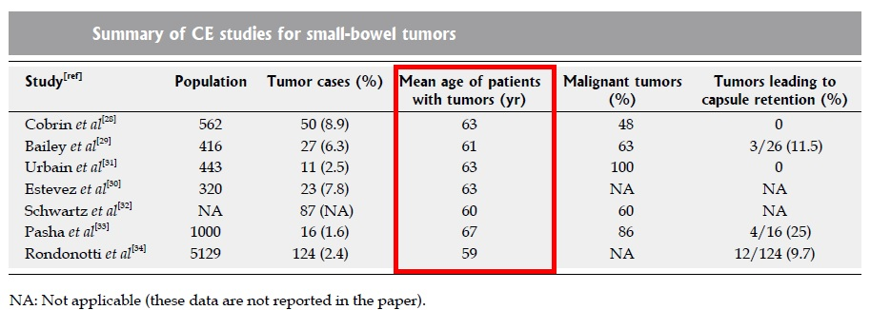
SUMMARY OF CAPSULE ENDOSCOPY STUDIES FOR SMALL BOWEL TUMORS
OGIB main clinical indication (> 90%)
Pennazio M, Rondonotti E, de Franchis R, WJG 2008

Slide 34
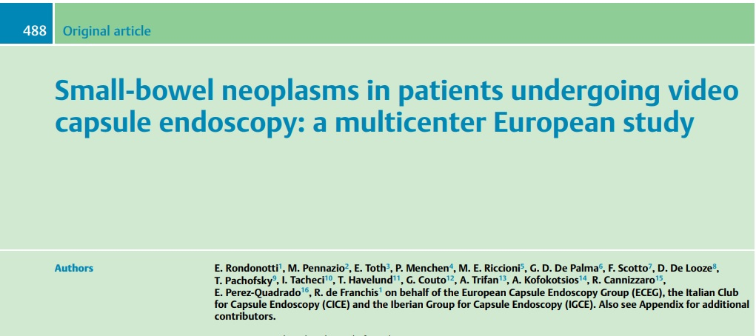
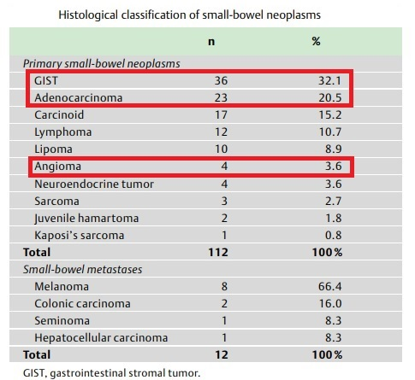

Slide 35
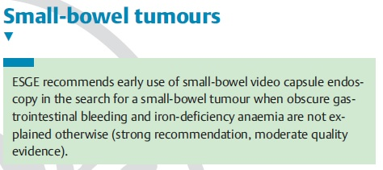
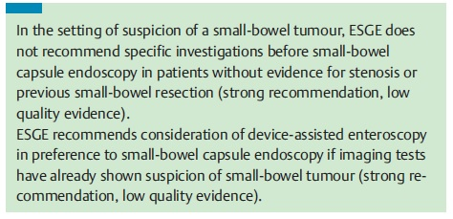
Clinical Case
SMALL BOWEL TUMORS
2015 European Society of Gastrointestinal Endoscopy (ESGE) Clinical Guideline

Slide 36
Clinical Case
Conclusions
Young patient (age <55)
Persistent/Recurrent Bleeding
(increasing transfusion or iron requirements)
Standard endoscopy not diagnostic
SUSPECTED SMALL BOWEL TUMOR

Slide 37
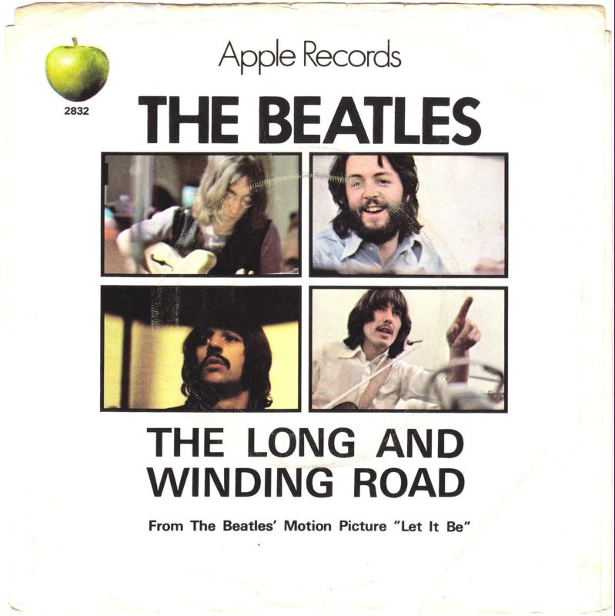
SMALL BOWEL «The long and winding road»

